Slide 1

Online E-Commerce Smartbuys
TEAM NAME : The Hivers
TEAM MEMBERS:-
Shree Rajan(Team Leader)
Suhana Kumari
Aashish Kishor

Slide 2

Understanding E-Commerce Platforms
Exploring the Role of Digital Marketplaces in Modern Shopping
An e commerce platform is a virtual market which buyers and sellers use to transact business easily. In the large scale growth of digital shopping we see these platforms have become very important as they provide convenience and world wide access. By familiarizing ourselves with how they function we also open up to the large set of opportunities present in the on line market.

Slide 3
300 million
Online shoppers worldwide
70%
Growth in e-commerce sales
90%
Of consumers prefer online shopping

Slide 4




User Types in E-Commerce
Admin
Seller
Buyer
All Users
Manage platform operations effectively and efficiently
Create and manage product listings seamlessly
Browse and purchase products effortlessly online
Collaborate for a smoother shopping experience

Slide 5
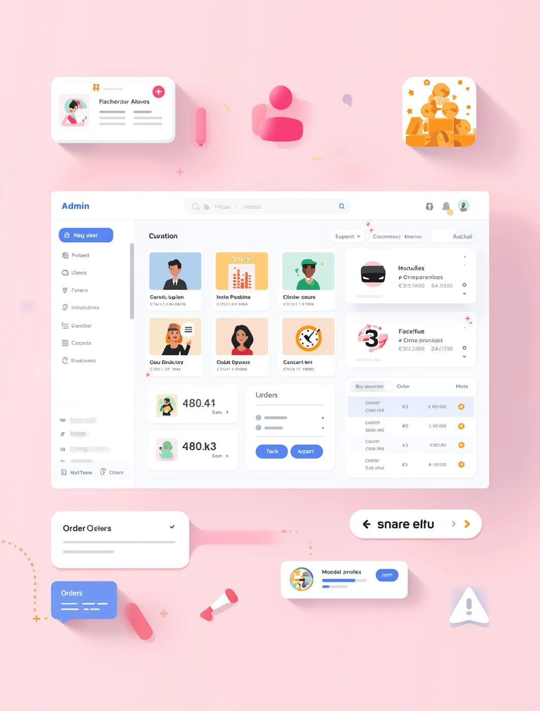
Admin Functionalities
Key Management Tasks for E-Commerce Platform Administration
Effective administration is essential for a successful e-commerce platform. Administrators have important duties, including managing users, overseeing products, and tracking orders. These tasks keep operations running smoothly, improve user experiences, and enable seamless transactions for both buyers and sellers.

Slide 6

Seller Functionalities
Key features that empower sellers to succeed online
The platform provides sellers with basic tools for efficient management of products and sales. We have easy product listing, inventory updates, and order processing which in turn makes daily operations smooth. Also we see that the very intuitive interface which we have saved sellers’ time, reduced their work load, improved performance and in the end supported business growth also which at the same time has made the shopping experience for buyers very smooth and consistent.

Slide 7

Buyer Functionalities
Essential features for a seamless online shopping experience
Buyers are able to go through a wide range of products, buy what they want with ease, and check the status of their orders in real time. We have put in place a very user friendly shopping environment which in turn increases convenience and satisfaction. Also with easy to use navigation buyers may find what best fits their wants and needs.

Slide 8

Admin Dashboard Features
Key Features
Manage users, products, and orders seamlessly with efficiency.

Slide 9
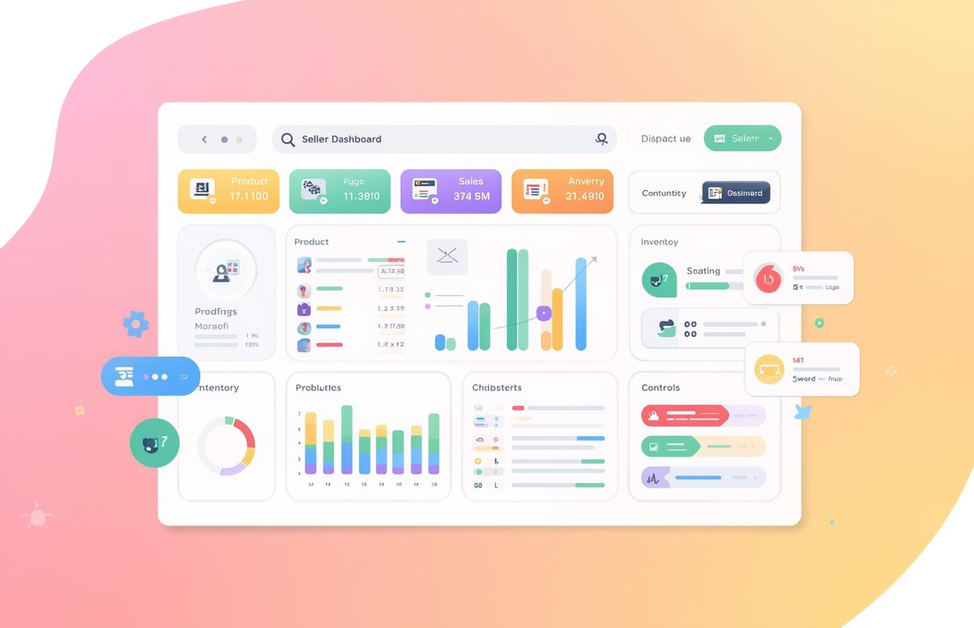
Seller Dashboard Overview
Dashboard Features
Manage products and analyze sales performance efficiently.

Slide 10
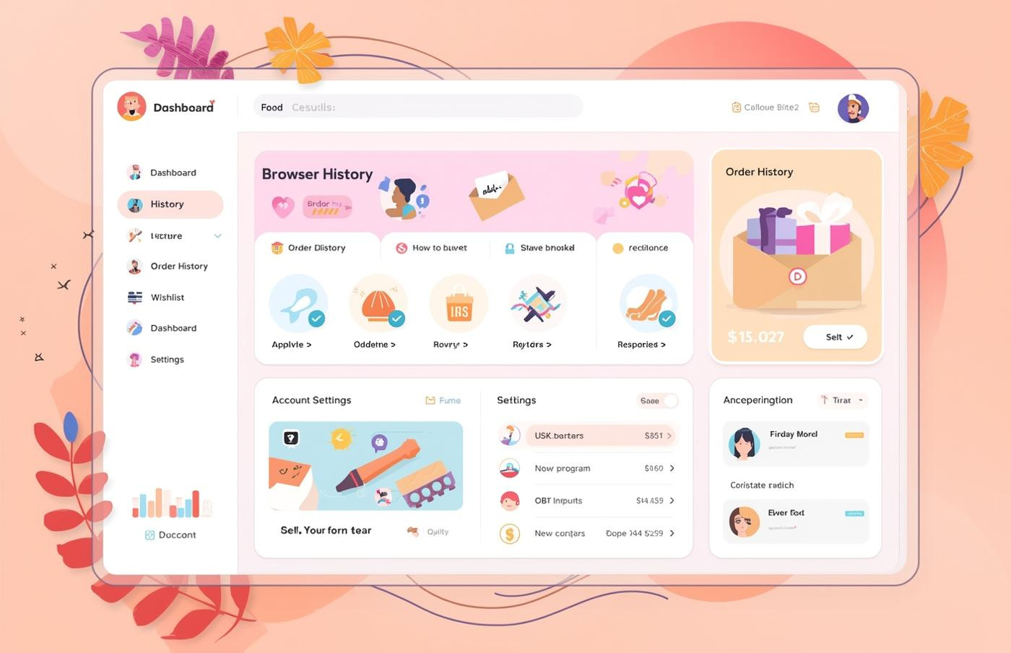
Buyer Dashboard Features
Key Components
Easy access to track purchases and preferences.

Slide 11
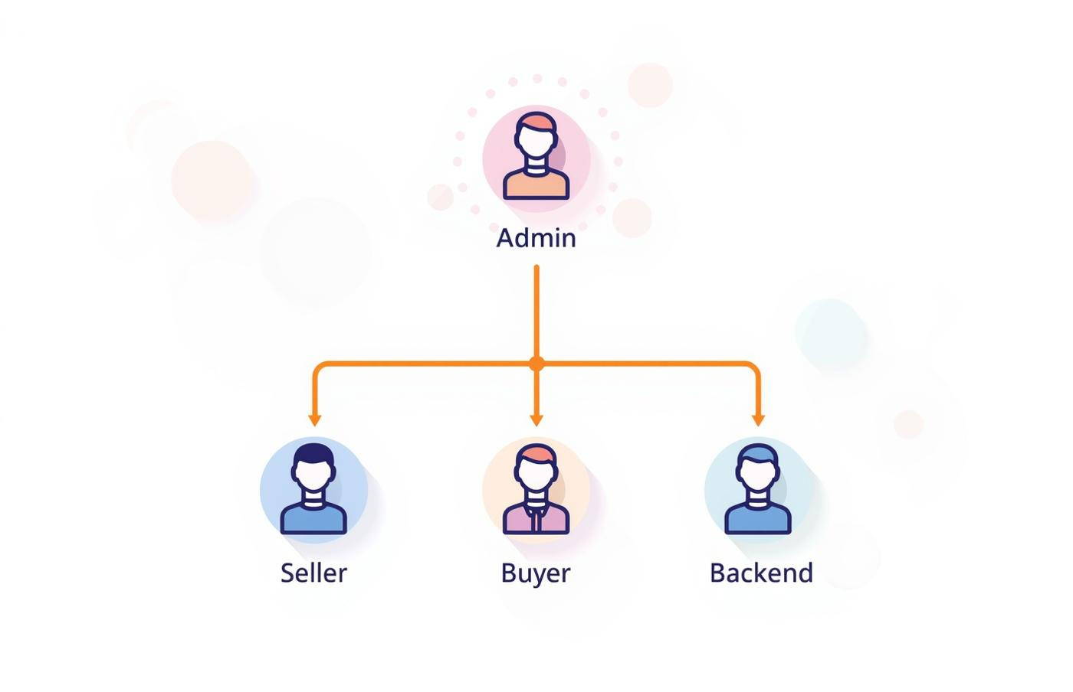
System Architecture and Data Flow
User Interaction
Clear pathways connect users to backend support.

Slide 12
Thank You

